Slide 1
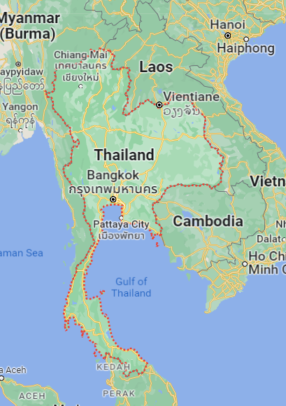
Pathumthani
Relax Comfort
SANE QUILTING
Fortune and star technology
HPN group holding
KGI customer in Thailand
Samutprakarn
Thai Bedding
Elegant fumiture
Thainon woven
Abby furniture manufacturing
SOLOMON
Soon Hong heng
Bangkok
DARLING MATTRESS
T S Gen
Victory industrial co., ltd.
Mangkang furniture
Chonburi
GOODSCOCR INDUSTRIAL CO., LTD.
PODIUM HOLDING GROUP CO., LTD.
WSP Decor & Design Co.,Ltd.
ROFU (Thailand) LIMITED
Samutsakorn
Sleepwell industries co. ltd
Grace bedding smart
Golden mold manufacturing co. ltd
SYNDA (THAILAND) COMPANY LIMITED
Rayong
EAST COAST FURNITECH
Tokyo parawood
PARAEASTERN INDUSTRY

Slide 2
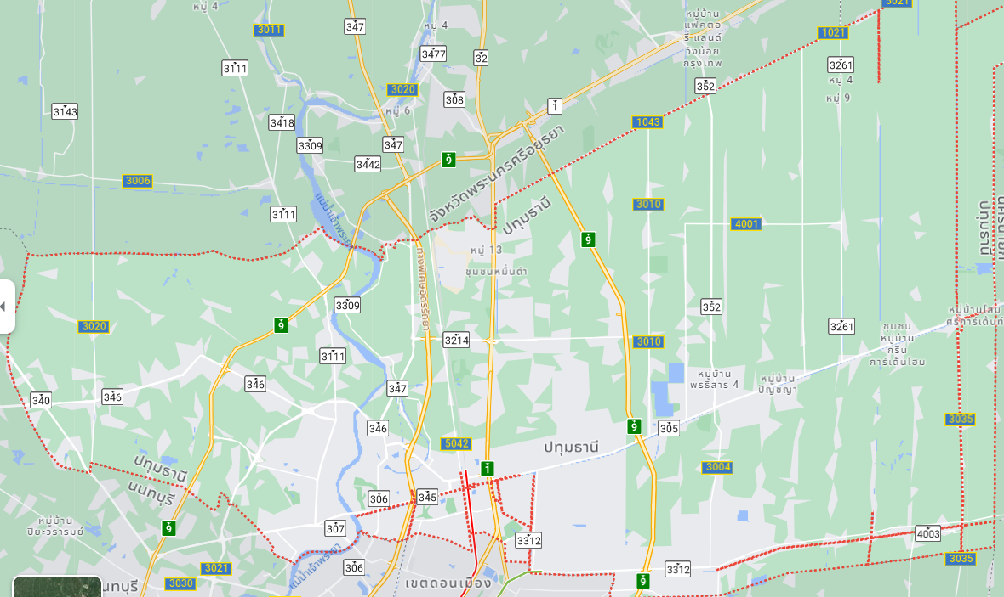

Pathumthani
Thai Foam Industries
Siam Ether Foam
Fortune and star technology
SANE QUILTING
HPN group holding
Relax Comfort
INOAC (Rangsit Branch)

Slide 3
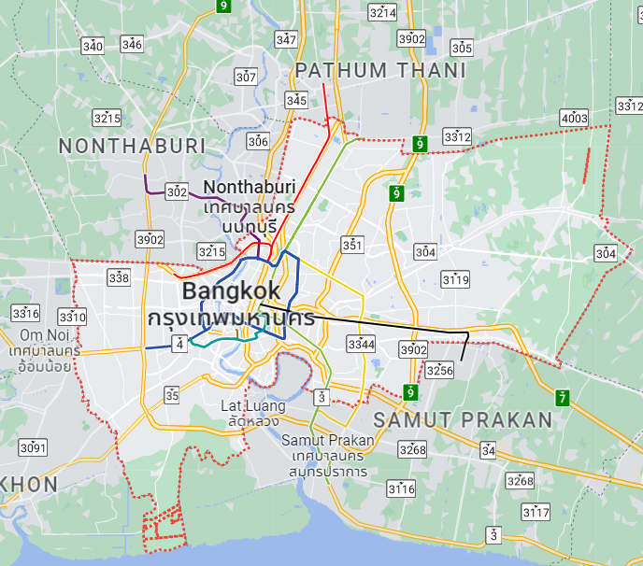
Bangkok
DARLING MATTRESS
Mangkang furniture
T.S.gen
INOAC (Bangkok)
Lucky Foam Industry
Foamcenter
Victory industrial co., ltd.

Slide 4
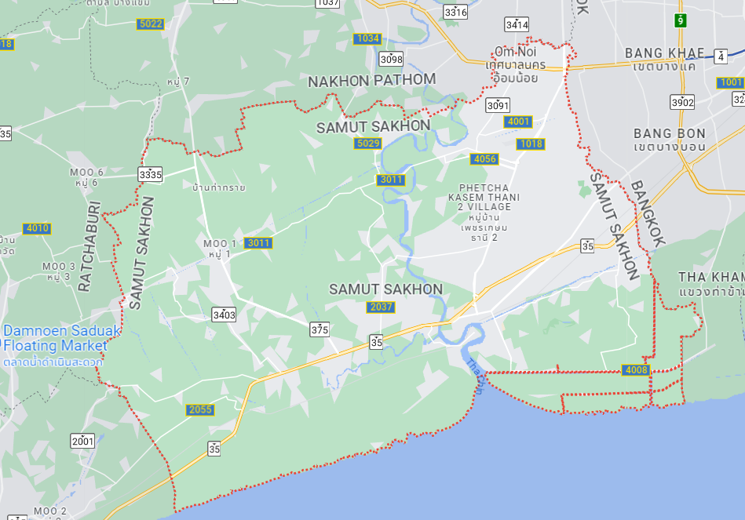
Samutsakorn
J.S.Foam
High Master Foam Products
Golden mold manufacturing
Grace bedding smart
Synda Factory
Sleepwell industries co. ltd

Slide 5
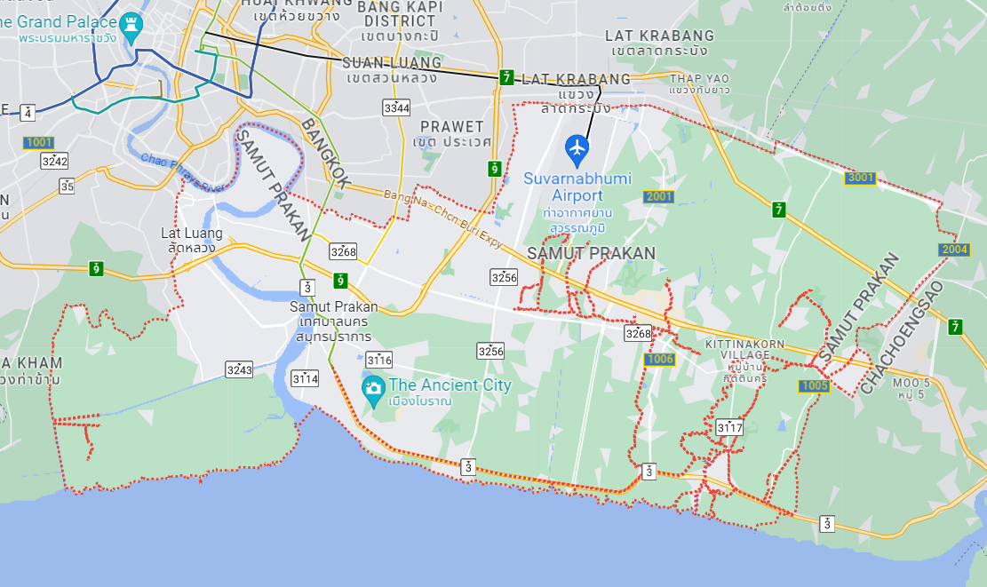
Samutprakarn
Thainon woven
Thai Bedding Co., LTD
Durafoam
Abby furniture
Solomon
Elegant furniture
Krungthep Foam
EASTERN FOAM PRODUCT
Soon hong heng
Chiao Fu Household

Slide 6
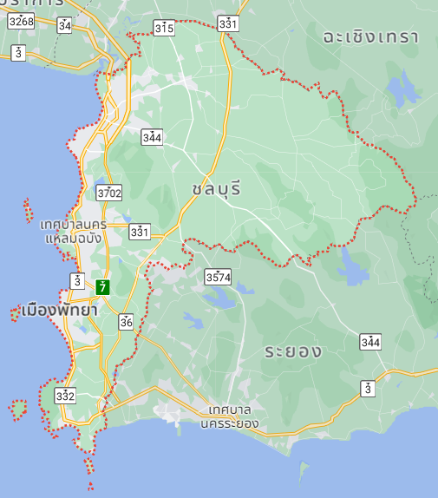
Chonburi
INOAC (AMATA Chonburi)
GOODSCOCR INDUSTRIAL
Podium holding group
WSP Decor & Design
Foam Tech International
Xinyuan
Rofu (Thailand)
INOAC (Siam Eastern Industrial Park)

Slide 7
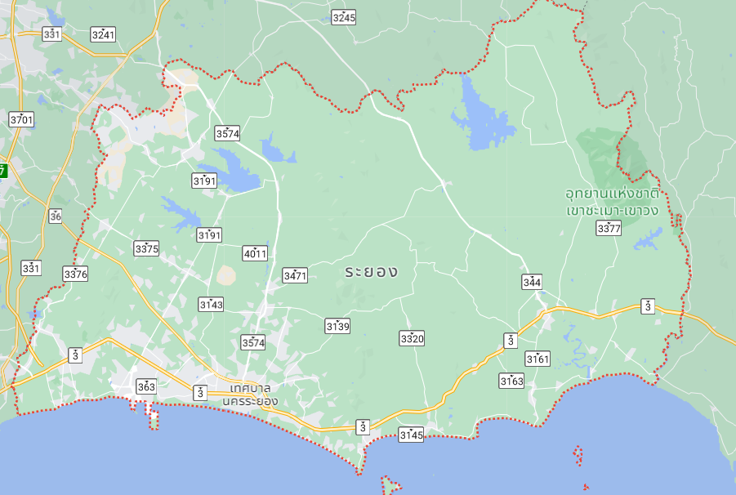
Rayong
INOAC (Siam Eastern Industrial Park)
Eastern Foam
EAST COAST FURNITECH
Tokyo Parawood
PARAEASTERN INDUSTRY

